Slide 1


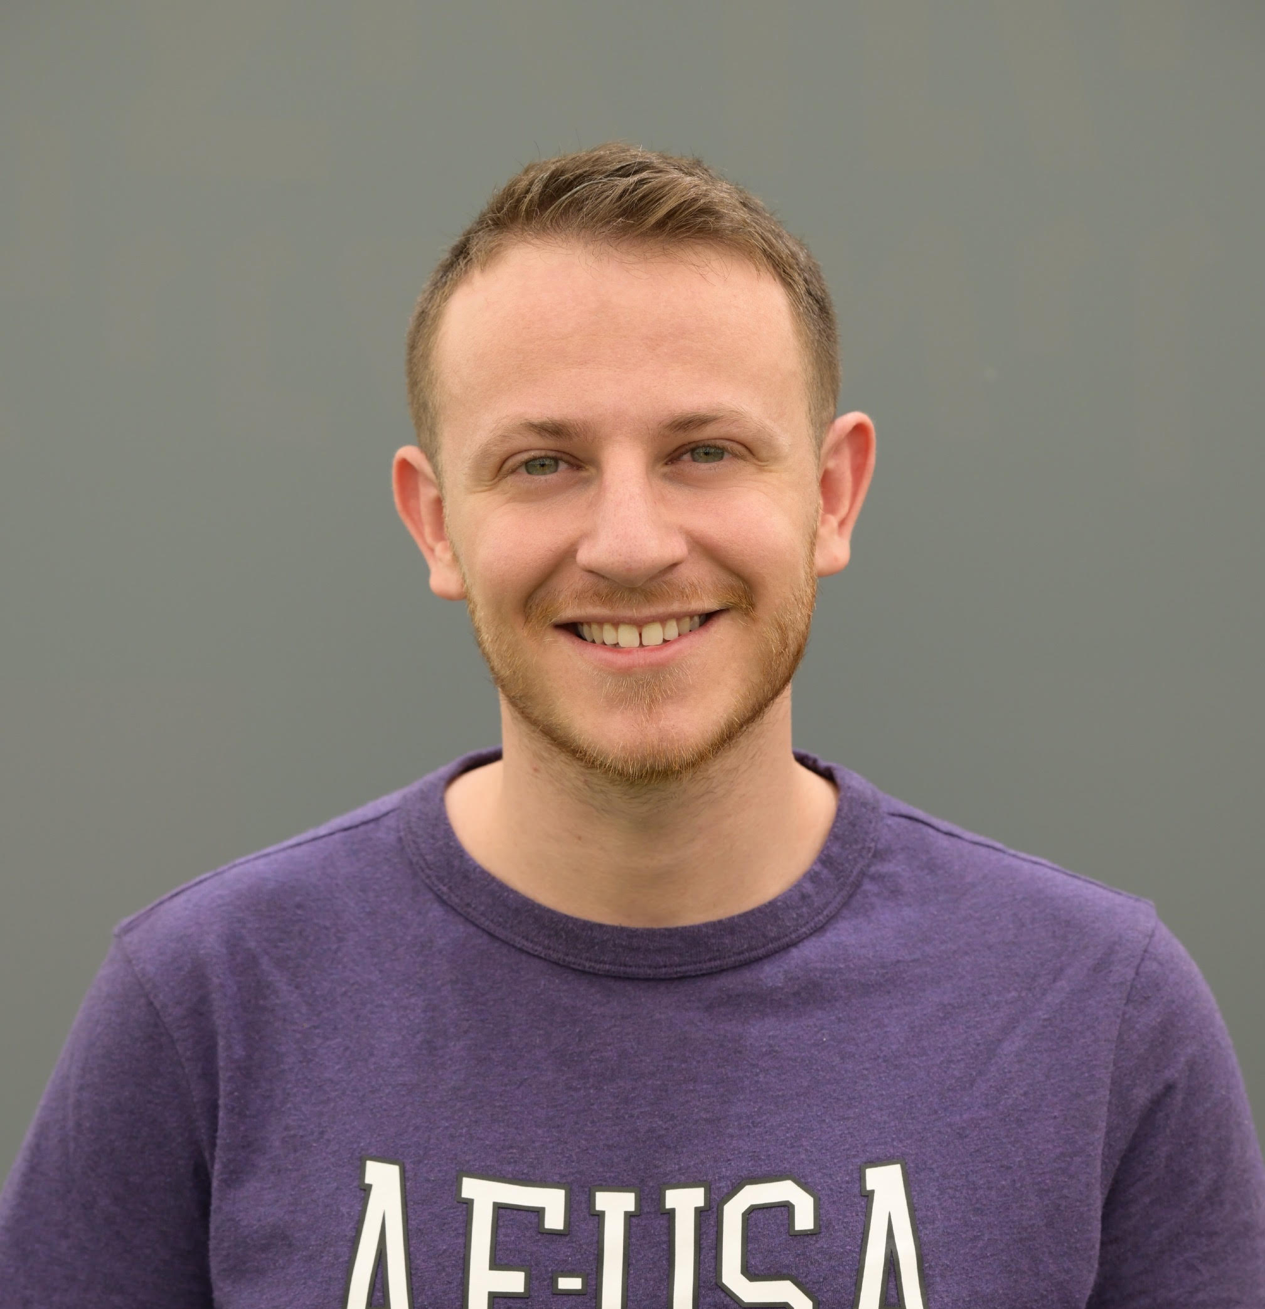
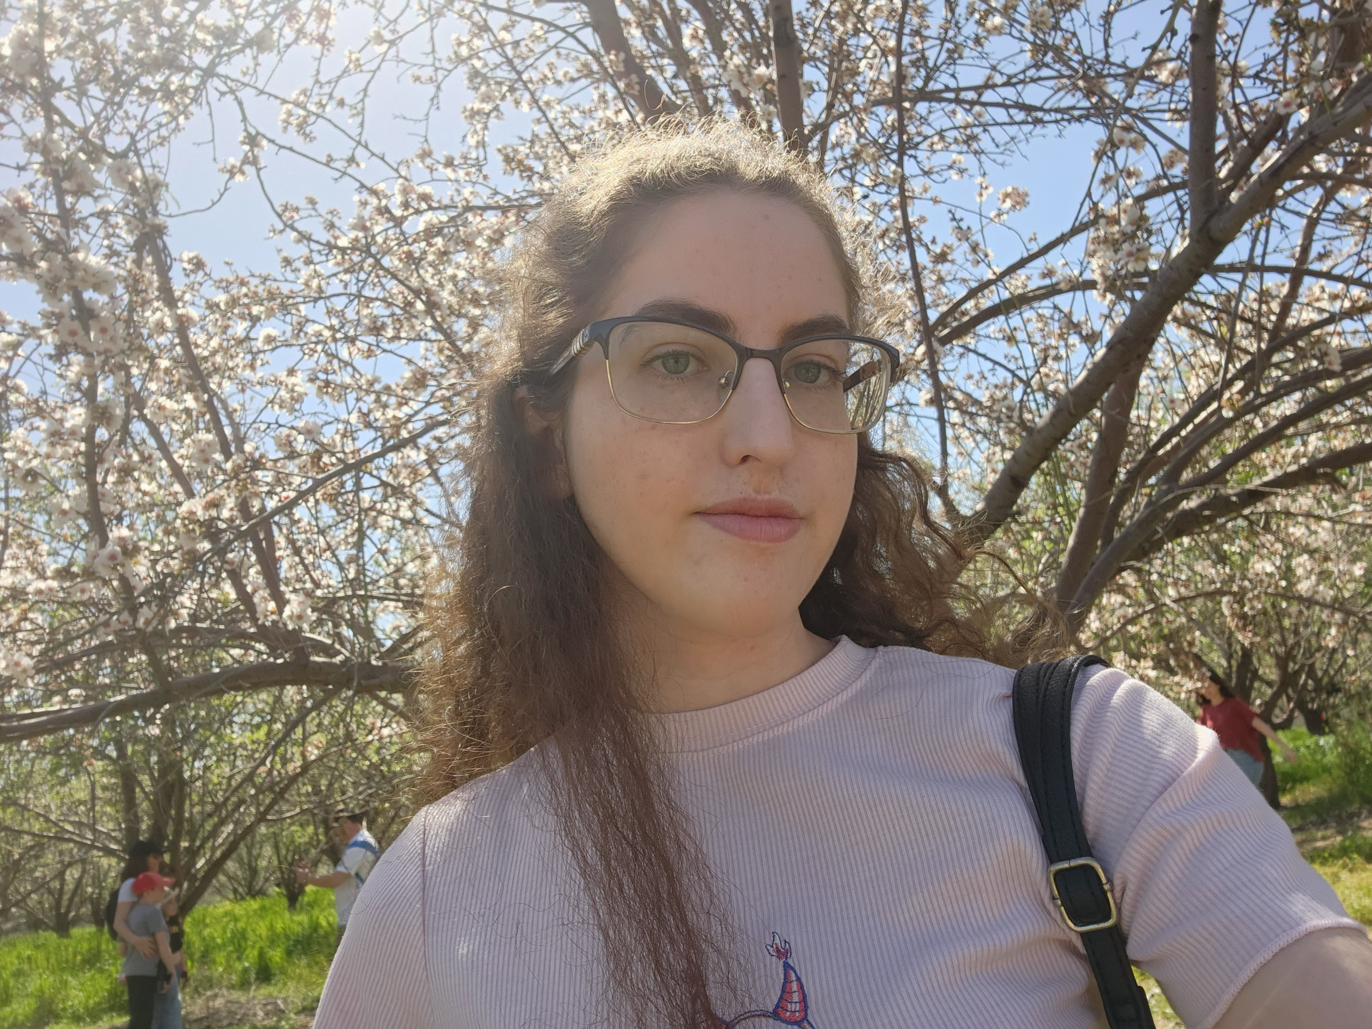

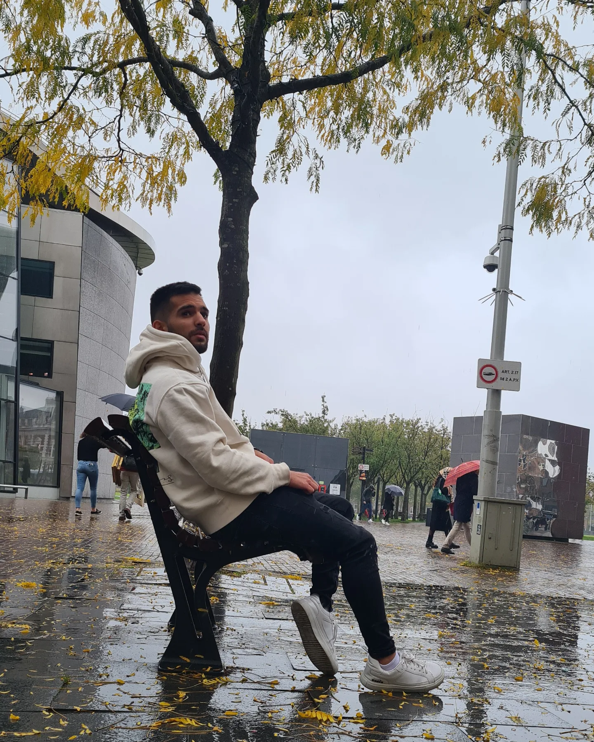

VolunTime
The new way of volunteering
HUJI Hackathon 2023

Slide 2



Problem 1 – The Place
Finding a place to volunteer at, especially one that’s
appealing to you, isn’t that easy as we’ve learned ourselves
Problems
Problem 2 – The Time
We are all busy people. Whether it is school or work, we
want something that would fit our time as best as possible
Problem 3 – The Requirements
And of course, you’d want to make sure you are qualified
for the position

Slide 3
Solution 1 – Generative AI
Generative AI is so powerful, it can use its power
to find the best places for one to volunteer at
Solutions
Solution 2 – Generative AI
Moreover, taking in account important criteria such as
availability, is a no problem for AI
Solution 3 – Generative AI
And finally, simulating real-life situations you might
experience as a volunteer, is the best assessment

Slide 4

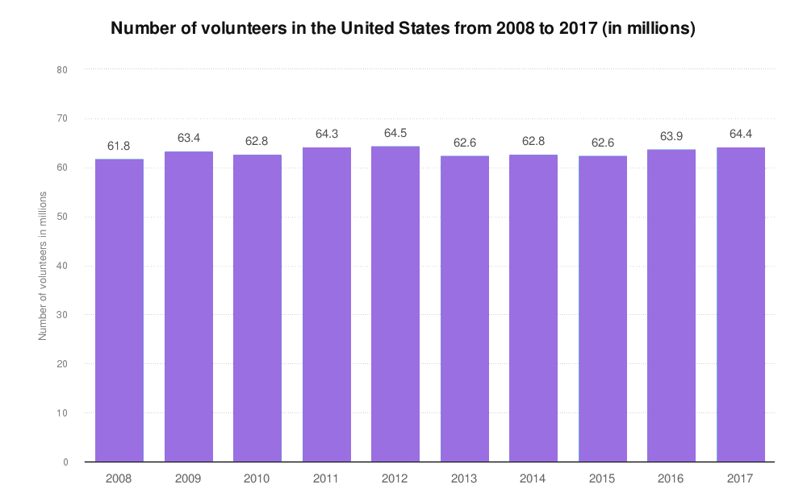
There are more good people than you’d expect!
Approximately, 30.3% of Americans volunteer in some
way or another. Everyone has different skills and passions, and with our
help, they can find the place that fits them best.
Market

Slide 5

We want to join the party!
With our idea, we can help millions of non-profit
organizations across the world, by finding new volunteers
that are the best fit for each role!
And our X-Factor?
We can provide strong tools to simulate everyday
situations you face as a volunteer, in various fields.
Combine it with optional feedback, and you got yourself
an awesome tool for personal growth!
Vision

Slide 6

We went serverless!
When designing the application, we decided to go for a
serverless architecture, making the cost of operation
ridiculously low!
The cheapest GPT model the better?
Going with the cheapest AI model OpenAI offers
is more than sufficient for our needs, making it
one of the lower expenses we foresee.
How cheap?
Approximately 2.015$ per 1,000 users!
Expenses

Slide 7
How about monetizing it?
When providing tools you can’t find anywhere else,
subscriptions are a must-go.
To whom?
Whether it is B2B or B2C, people would benefit
from our feedback and on-top user experience!
There are more than 10,000,000 non-profit organizations
striving for a game-changing product.
Revenue

Slide 8

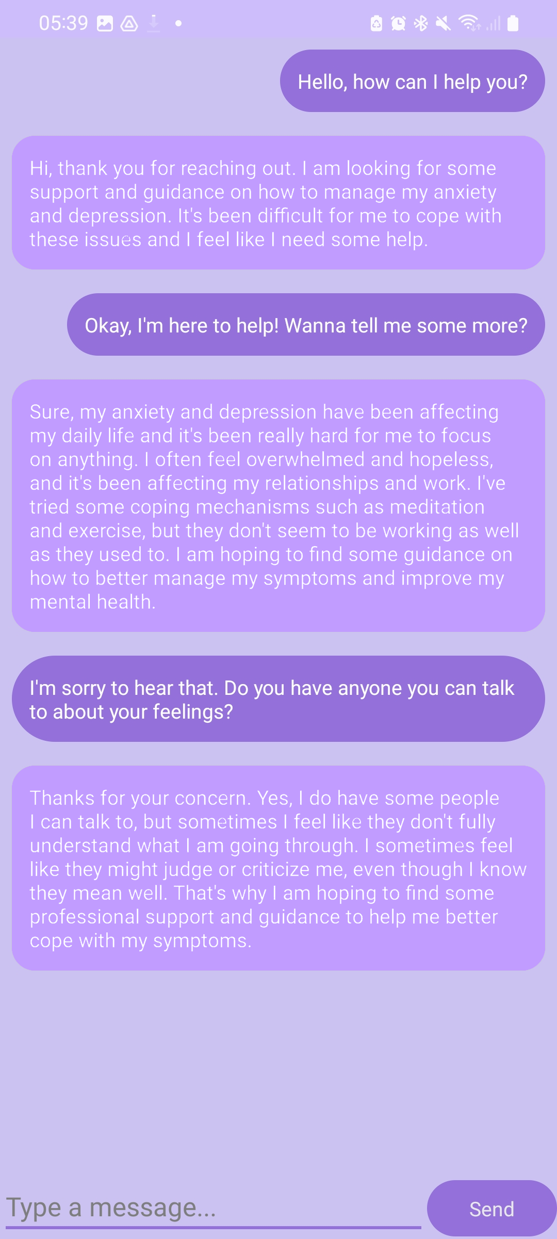

Demo
On the right you can see a conversation with an AI pretending to be someone dealing with mental health, and us, simulating a possible situation of being an Eran volunteer.

